Slide 1
INTERACTIVITY

Slide 2
Dialog design is focused almost entirely on the choice and specification of appropriate sequences of actions and corresponding changes in the interface state.
It is typically not used at a fine level of detail and deliberately ignores the semantic level of an interface: for example, the validation of numeric information in a forms-based system.
It is worth remembering that interactivity is the defining feature of an interactive system. This can be seen in many areas of HCI.

Slide 3
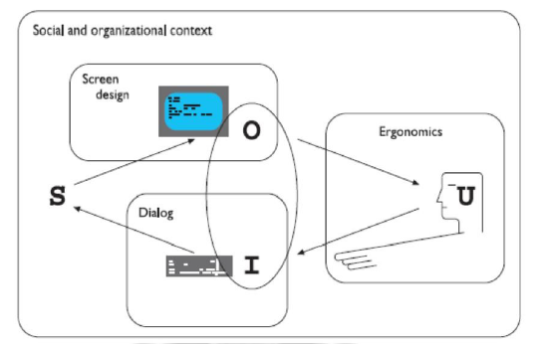

Slide 4
For example, the recognition rate for speech recognition is too low to allow transcription from tape, but in an airline reservation system, so long as the system can reliably recognize yes and no it can reflect back its understanding of what you said and seek confirmation.
Speech-based input is difficult, speech-based interaction easier.
Also, in the area of information visualization the most exciting developments are all where users can interact with visualization in real time, changing parameters and seeing the effect.

Slide 5
Interactivity is also crucial in determining the feel of a WIMP environment. All WIMP systems appear to have virtually the same elements: windows, icons, menus, pointers, dialog boxes, buttons, etc.
In fact, menus are a major difference between the MacOS and Microsoft Windows environments: in MacOS you have to keep the mouse depressed throughout menu selection;in Windows you can click on the menu bar and a pull-down menu appears and remains there until an item is selected or it is cancelled. Similarly the detailed behavior of buttons is quite complex.

Slide 6
In WIMP environments, the user takes the initiative, with many options and often many applications simultaneously available.
The exceptions to this are pre-emptive parts of the interface, where the system for various reasons wrests the initiative away from the user, perhaps because of a problem or because it needs information in order to continue.
Interactivity is also critical in dealing with errors. We discussed slips and mistakes earlier in the chapter, and some ways to try to prevent these types of errors

Slide 7
The other way to deal with errors is to make sure that the user or the system is able to tell when errors have occurred.
If users can detect errors then they can correct them. So, even if errors occur, the interaction as a whole succeeds. Several of the principles in deal with issues that relate to this.
This ability to detect and correct is important both at the small scale of button presses and keystrokes and also at the large scale.

